Slide 1
Minimum spanning tree

Slide 2
Minimum spanning tree
Given a weighted undirected graph.
We want to find a subtree of this graph which connects all vertices (i.e. it is a spanning tree) and has the least weight (i.e. the sum of weights of all the edges is minimum) of all possible spanning trees.
This spanning tree is called a minimum spanning tree.

Slide 3
Minimum spanning tree
In the left image you can see a weighted undirected graph, and in the right image you can see the corresponding minimum spanning tree.
1
5
2
1
2
9
8
3
4
3
1
3
3
1
3
4
4
7
4
7
5
6
5
6
2
2

Slide 4
Minimum spanning tree Properties
A minimum spanning tree of a graph is unique, if the weight of all the edges are distinct. Otherwise, there may be multiple minimum spanning trees. (Specific algorithms typically output one of the possible minimum spanning trees).
Minimum spanning tree is also the tree with minimum product of weights of edges.
It can be easily proved by replacing the weights of all edges with their logarithms.
The maximum spanning tree (spanning tree with the sum of weights of edges being maximum) of a graph can be obtained similarly to that of the minimum spanning tree, by changing the signs of the weights of all the edges to their opposite and then applying any of the minimum spanning tree algorithm.

Slide 5
Minimum spanning tree Simple algorithm
Kruskal's algorithm initially places all the nodes of the original graph isolated from each other, to form a forest of single node trees.
Then gradually merges these trees, combining at each iteration any two of all the trees with some edge of the original graph.
Before the execution of the algorithm, all edges are sorted by weight (in non-decreasing order).
Then begins the process of unification: pick all edges from the first to the last (in sorted order), and if the ends of the currently picked edge belong to different subtrees, these subtrees are combined, and the edge is added to the answer.
After iterating through all the edges, all the vertices will belong to the same sub-tree, and we will get the answer.

Slide 6
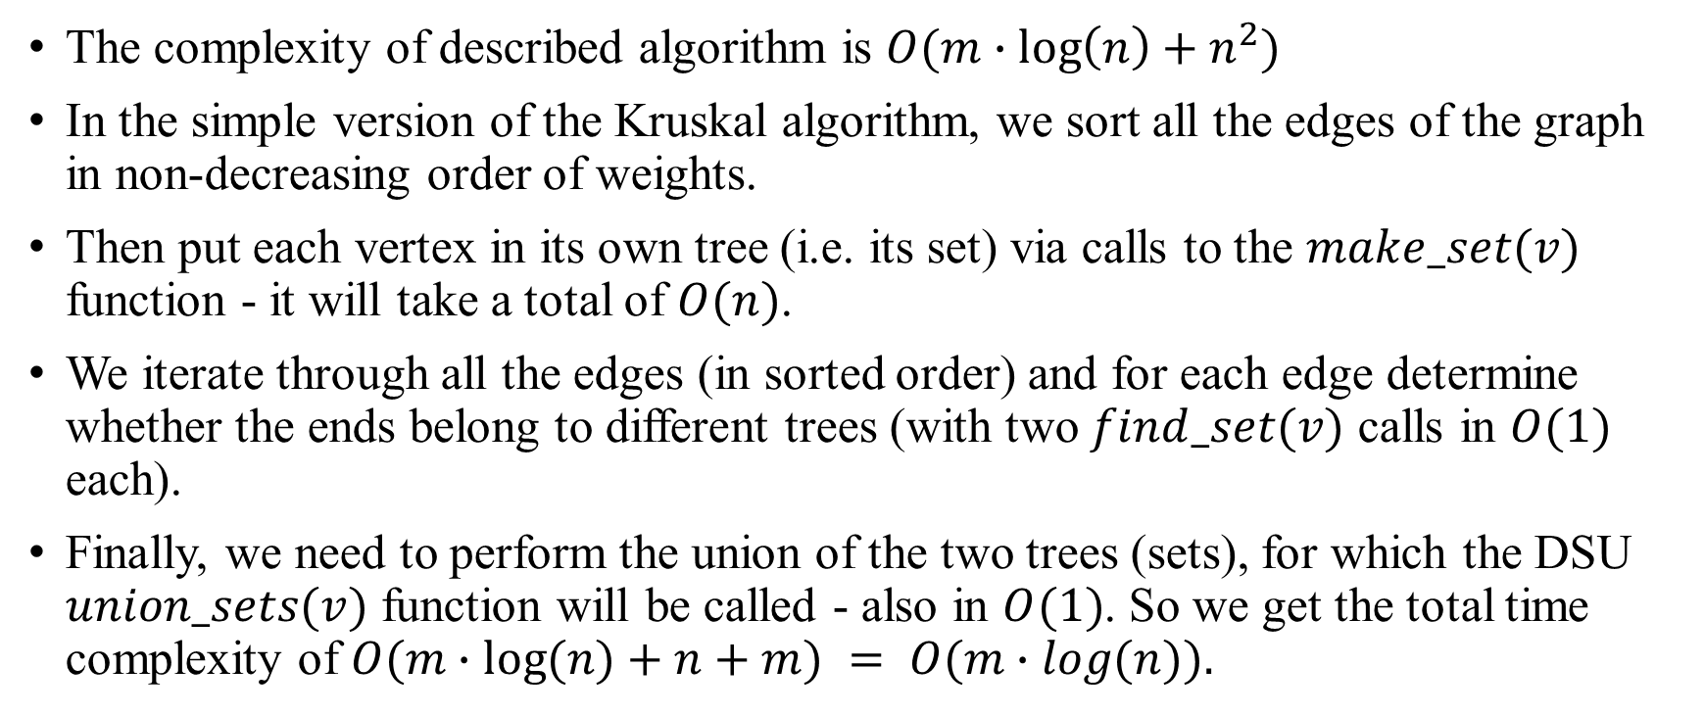
Minimum spanning tree Advanced algorithm: DSU
The complexity of described algorithm is $O(m∙\log\left(n\right)+n^{2})$
In the simple version of the Kruskal algorithm, we sort all the edges of the graph in non-decreasing order of weights.
Then put each vertex in its own tree (i.e. its set) via calls to the $make_set(v)$ function - it will take a total of $O(n)$.
We iterate through all the edges (in sorted order) and for each edge determine whether the ends belong to different trees (with two $find_set(v)$ calls in $O(1)$ each).
Finally, we need to perform the union of the two trees (sets), for which the DSU $union_sets(v)$ function will be called - also in $O(1)$. So we get the total time complexity of $O(m∙log⁡(n)+n+m) = O(m∙log(n)).$

